Slide 1

WELCOME TO OUR CLASS
ENGLISH 9
Phan Tay Ho Secondary School
Teacher: Nguyen Thi Thu Thuy

Slide 2
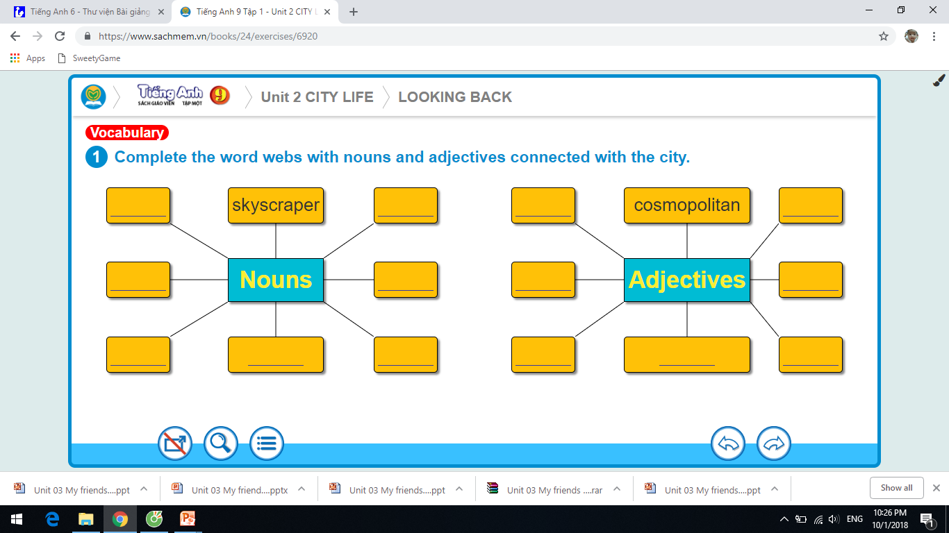

Slide 3
Monday, October 14th, 2019
Period 15:
Unit 2: City life
Lesson 7: Looking back & Project

Slide 4
Activity 2: Put one word from the box in each gap.
full
bored
fabulous
urban
noisy
crowded
fascinating
A big city is full of life. City life is more modern and (1)………………. than elsewhere. It is usually very busy and (2)……………… , even at night.
Life in a big city starts early in the morning. Soon the roads are (3)…………………. of vehicles. School children in their uniforms can be seen on the pavement, walking or waiting for buses. People rush to work. With every passing hour, the traffic goes on increasing. The shops and the market places remain (4)………………… till the evening hours.
Certainly (5)………………… life has certain charms. It offers great opportunities and challenges, especially for the young. There are lots of things to do, and facilities are well developed. There are (6)…………………….. places for amusement and recreation. One never feels (7) ………………. in a city.

Slide 5
Activity3: Complete each sentence with the word given, using comparison. Include any other necessary words.
as (so) interesting as
1.The last exhibition was not …………………………..… this one. (INTERESTING)
2. This city is developing ………………………….….. in the region. (FAST)
3. Let’s take this road. It is …………………….…….way to the city. (SHORT)
4. I was disappointed as the film was ……………….…........ than I had expected. (ENTERTAINING)
5. You’re not a safe driver! You should drive ………………… . (CAREFULLY)
the fastest
the shortest / a shorter
less entertaining
more carefully.

Slide 6
Activity4: Complete each gap with a phrasal verb from the box. Change the form of the verb if necessary.
cheer up get over turn back find out turn down go on
1.She ………...…… his invitation to the party and now he’s really upset.
2. What’s …………..…….in the street over there? Open the door!
3. Lots of fruit and vegetables will help you ………….. your cold.
4. My brother was ………………..with a trip to the zoo.
5.The road was jammed, so we had to ……………… and find an alternative route.
6. I have …………….. about a fabulous place where we can go for a picnic this weekend.
turned down
going on
get over
cheered up
turn back
found out

Slide 7
Activity 5: Rewrite each sentence so that it has a similar meaning
and contains the word in capitals.
1.Don’t leave the lights on when you leave the classroom. (OFF)
→Turn off the lights when you leave the classroom.
2.Mai spent her childhood in a small town in the south. (UP)
→Mai grew up in a small town in the South.
3.Kathy checked the restaurant on her mobile phone. (LOOKED)
→Kathy looked up the restaurant on her mobile phone.
4.My grandmother has recovered from her operation. (GOT)
→My grandmother has got over her operation.
5.We are really expecting to see you again with pleasure.(LOOK)
→We are looking forward to seeing you again.

Slide 8
Activity6: Complete the table ( work in two teams)
City/ Town | Man-made/ natural attraction
Team A gives the name of a city/ town in Viet Nam.
Team B says its attraction. The team with the most items wins.
Ex: Team A: Hue city
Team B: It has Hue conical hats

Slide 9
PROJECT
Writing interesting notices
what is the notice ?
Do you know it?

Slide 10

1. Put the item in these scrambled notices in the correct order, starting with the heading in capitals.
A
Classes as normal tomorrow
Group 9B + 9D to Gym
QUIET PLEASE
Exam in progress

Slide 11
1. Put the item in these scrambled notices in the correct order, starting with the heading in capitals.
A
QUIET PLEASE
Exam in progress
Group 9B + 9D to Gym
Classes as normal tomorrow

Slide 12

1. Put the item in these scrambled notices in the correct order, starting with the heading in capitals.
B
Tom Hall every evening
Ring Dylan on 42564039
Offered by native teachers
ENGLISH CONVERSATION LESSONS
Language exchange also a possibility

Slide 13
1. Put the item in these scrambled notices in the correct order, starting with the heading in capitals.
B
ENGLISH CONVERSATION LESSONS
Town Hall every evening
Offered by native teachers
Language exchange also a possibility
Ring Dylan on 42564039

Slide 14
Where are you most likely to find these notices ?
School
Office
Or in a city

Slide 15
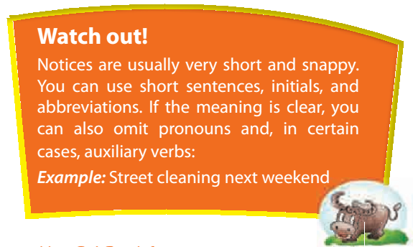
Where are you most likely to find these notices?

Slide 16
In a town or city, you can see a lot of notices. A notice should attract the reader’s attention and send a message in just a few words. It may be effective to use different sizes of writing or type, or to put the heading in colour. Above all, the notice must be easy to understand.

Slide 17
Homework
Redo exercises.
Do Project (1,2,3) at home.
- Prepare Unit 3: Getting started

Slide 18


